Slide 1
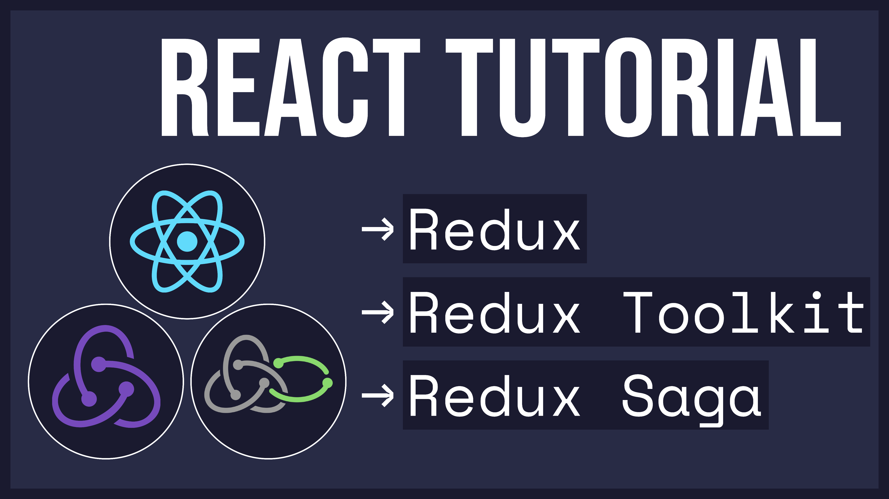
Notes:
Hello everyone and welcome to my next tutorial! In this series, I’ll be explaining some state management concepts in React, including Redux Toolkit and Redux Saga.

Slide 2

Introduction to Redux
Concepts and Data Flow
Notes:
First, I’ll explain some basic concepts and also discuss the Redux data flow at a high level.

Slide 3
🤔 What is Redux?
💡 Redux allows you to manage your app’s state in a single place
Notes:
Redux can be summarized as a tool to manage your app’s state in a single place.

Slide 4
😀 When to Use Redux?
You have large amounts of application state that are needed in many places in the app
The app state is updated frequently
The logic to update that state may be complex
The app has a medium or large-sized codebase, and might be worked on by many people
You need to see how that state is being updated over time
Notes:
There are a lot of use cases for Redux, some of which are listed here.

Slide 5
😔 Redux Drawbacks
There are more concepts to learn, and more code to write…
Notes:
However, with any tool, there are trade-offs. I think it’s important to be aware of these drawbacks.
Using redux comes with much more concepts to learn, and code to write. You can also argue that using Redux adds some complexity to the codebase.

Slide 6
👨‍🏫 Redux Concepts
1) Store
Redux application state lives in an object called the store
Notes:
Now that we’ve gone through what Redux is, let’s dive a bit into the concepts we’ll see again and again.
First and foremost, is the store, where we keep all our redux application state.

Slide 7
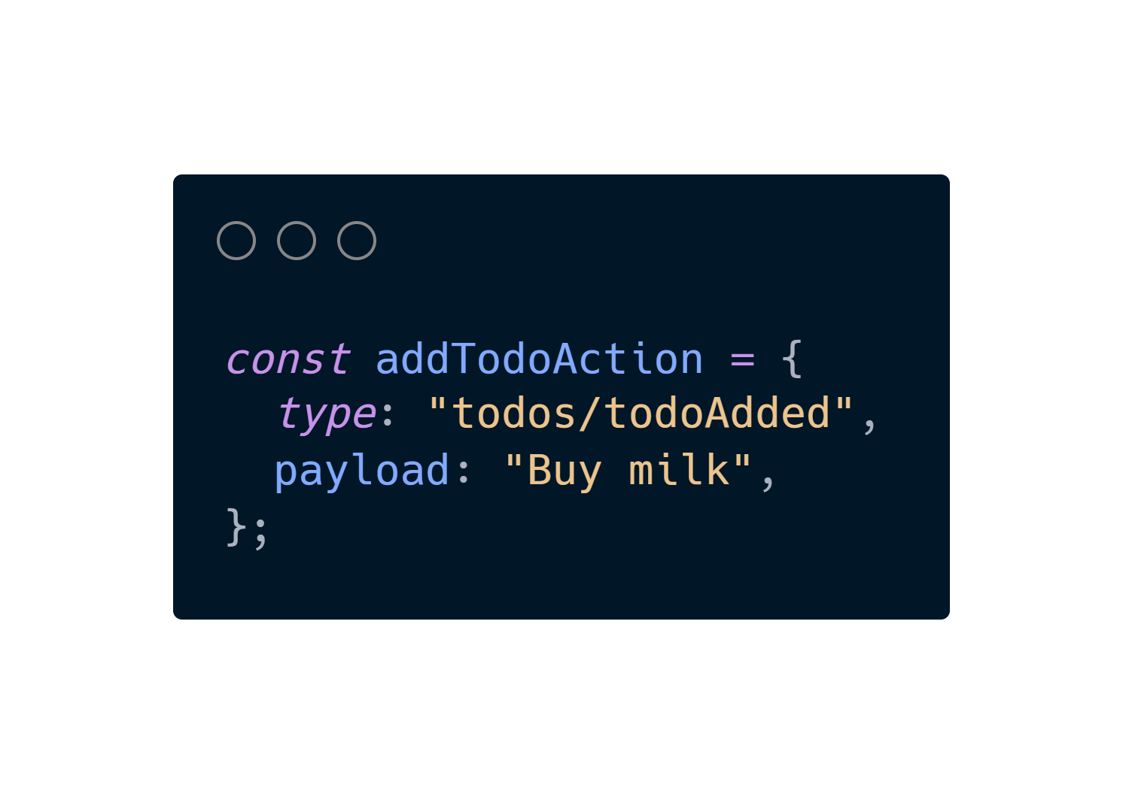
👨‍🏫 Redux Concepts
2) Action
The actions (events) that occur in the app based on user input, and trigger updates in the state
An action is a plain JavaScript object that typically has the following fields:
- type: string that gives this action a descriptive name
- payload: additional information about what happened
Notes:
Next, we have the concept of actions.
An action is an event that occurs in the app to trigger updates in the state. Typically, this is occurs based on user input.
Basically, you can think of an action as an event that describes something that happened in the application.
In more detail, an action is a plain object that is composed of two fields: a type and a payload.
The type is just a string that gives the action a descriptive name.
The payload is any additional information about what happened.
If we have a look at the code snippet, we’ll see the type is “todo/todoAdded” and the payload is “Buy milk”. This is a good example for an action that would be dispatched in a Todo List Application.

Slide 8
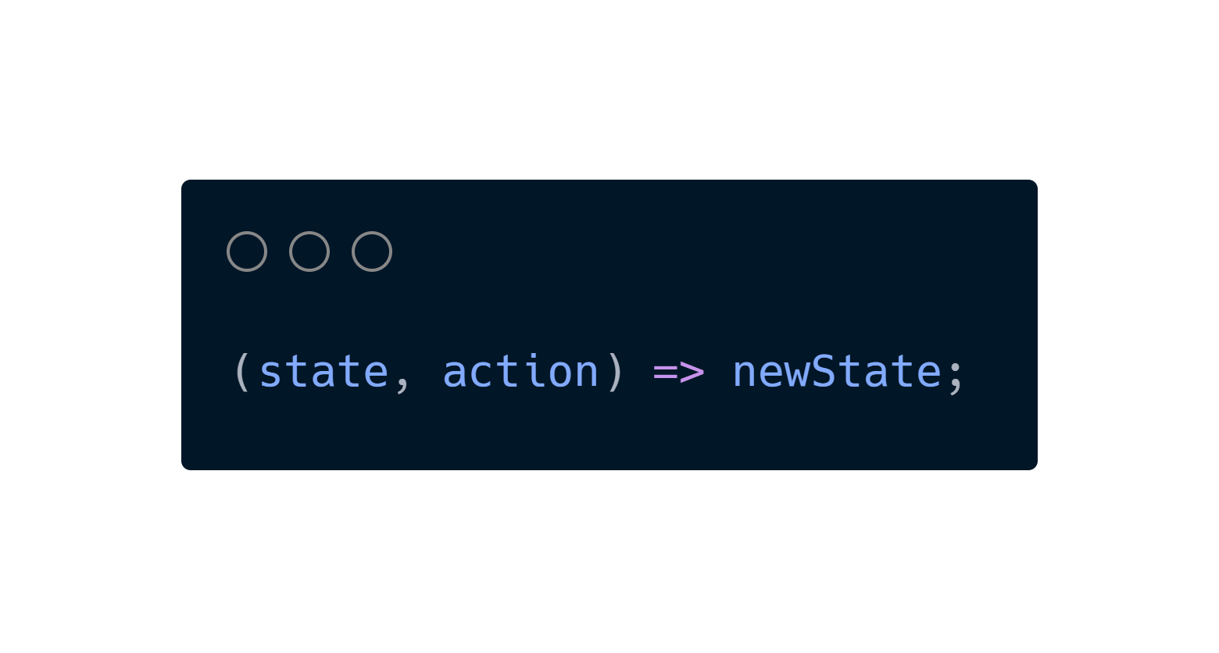
👨‍🏫 Redux Concepts
3) Reducer
A reducer is a function that receives the current state and an action object, then decides how to update the state.
You can think of a reducer as an event listener which handles events based on the received action (event) type.
Notes:
The next concept we’ll discuss is a reducer.
A reducer is simply a function that receives the current state and an action object, then decides how to update the state.

Slide 9

🧠 Redux Data Flow
👉 Let’s pretend a user clicks “deposit $10”
Summary of Data Flow
The action is dispatched to the Redux store
The store runs the reducer function, and calculates the new state value
The store notifies all parts of the UI that are subscribed
Each component that sees its data has changed forces a re-render with the new data, so it can update what's shown on the screen
Notes:
I took this gif from the Redux documentation, which really helps visualize all these concepts together. I’ll also link it in the description. (https://redux.js.org/tutorials/fundamentals/part-2-concepts-data-flow)
Let’s start with the UI, which contains two buttons: deposit $10 and withdraw $10.
Let’s pretend a user clicks on the deposit $10 button.
The action is dispatched to the Redux store
The store runs the reducer function, and calculates the new state value
The store notifies all parts of the UI that are subscribed
Each component that sees its data has changed forces a re-render with the new data, so it can update what's shown on the screen

Slide 10
Redux Toolkit
Overview
Notes:
Now that we’ve summarized Redux, let’s get into some code snippets of Redux Toolkit so we can see some more tangible examples.

Slide 11
🤔 What is Redux Toolkit?
The Redux Toolkit package is intended to be the standard way to write Redux logic.
💡 In essence, it makes writing Redux logic much easier.
Notes:
But what is Redux Toolkit?
The Redux Toolkit package is intended to be the standard way to write Redux logic.
Basically, it’s just a package that makes writing Redux logic much easier.

Slide 12
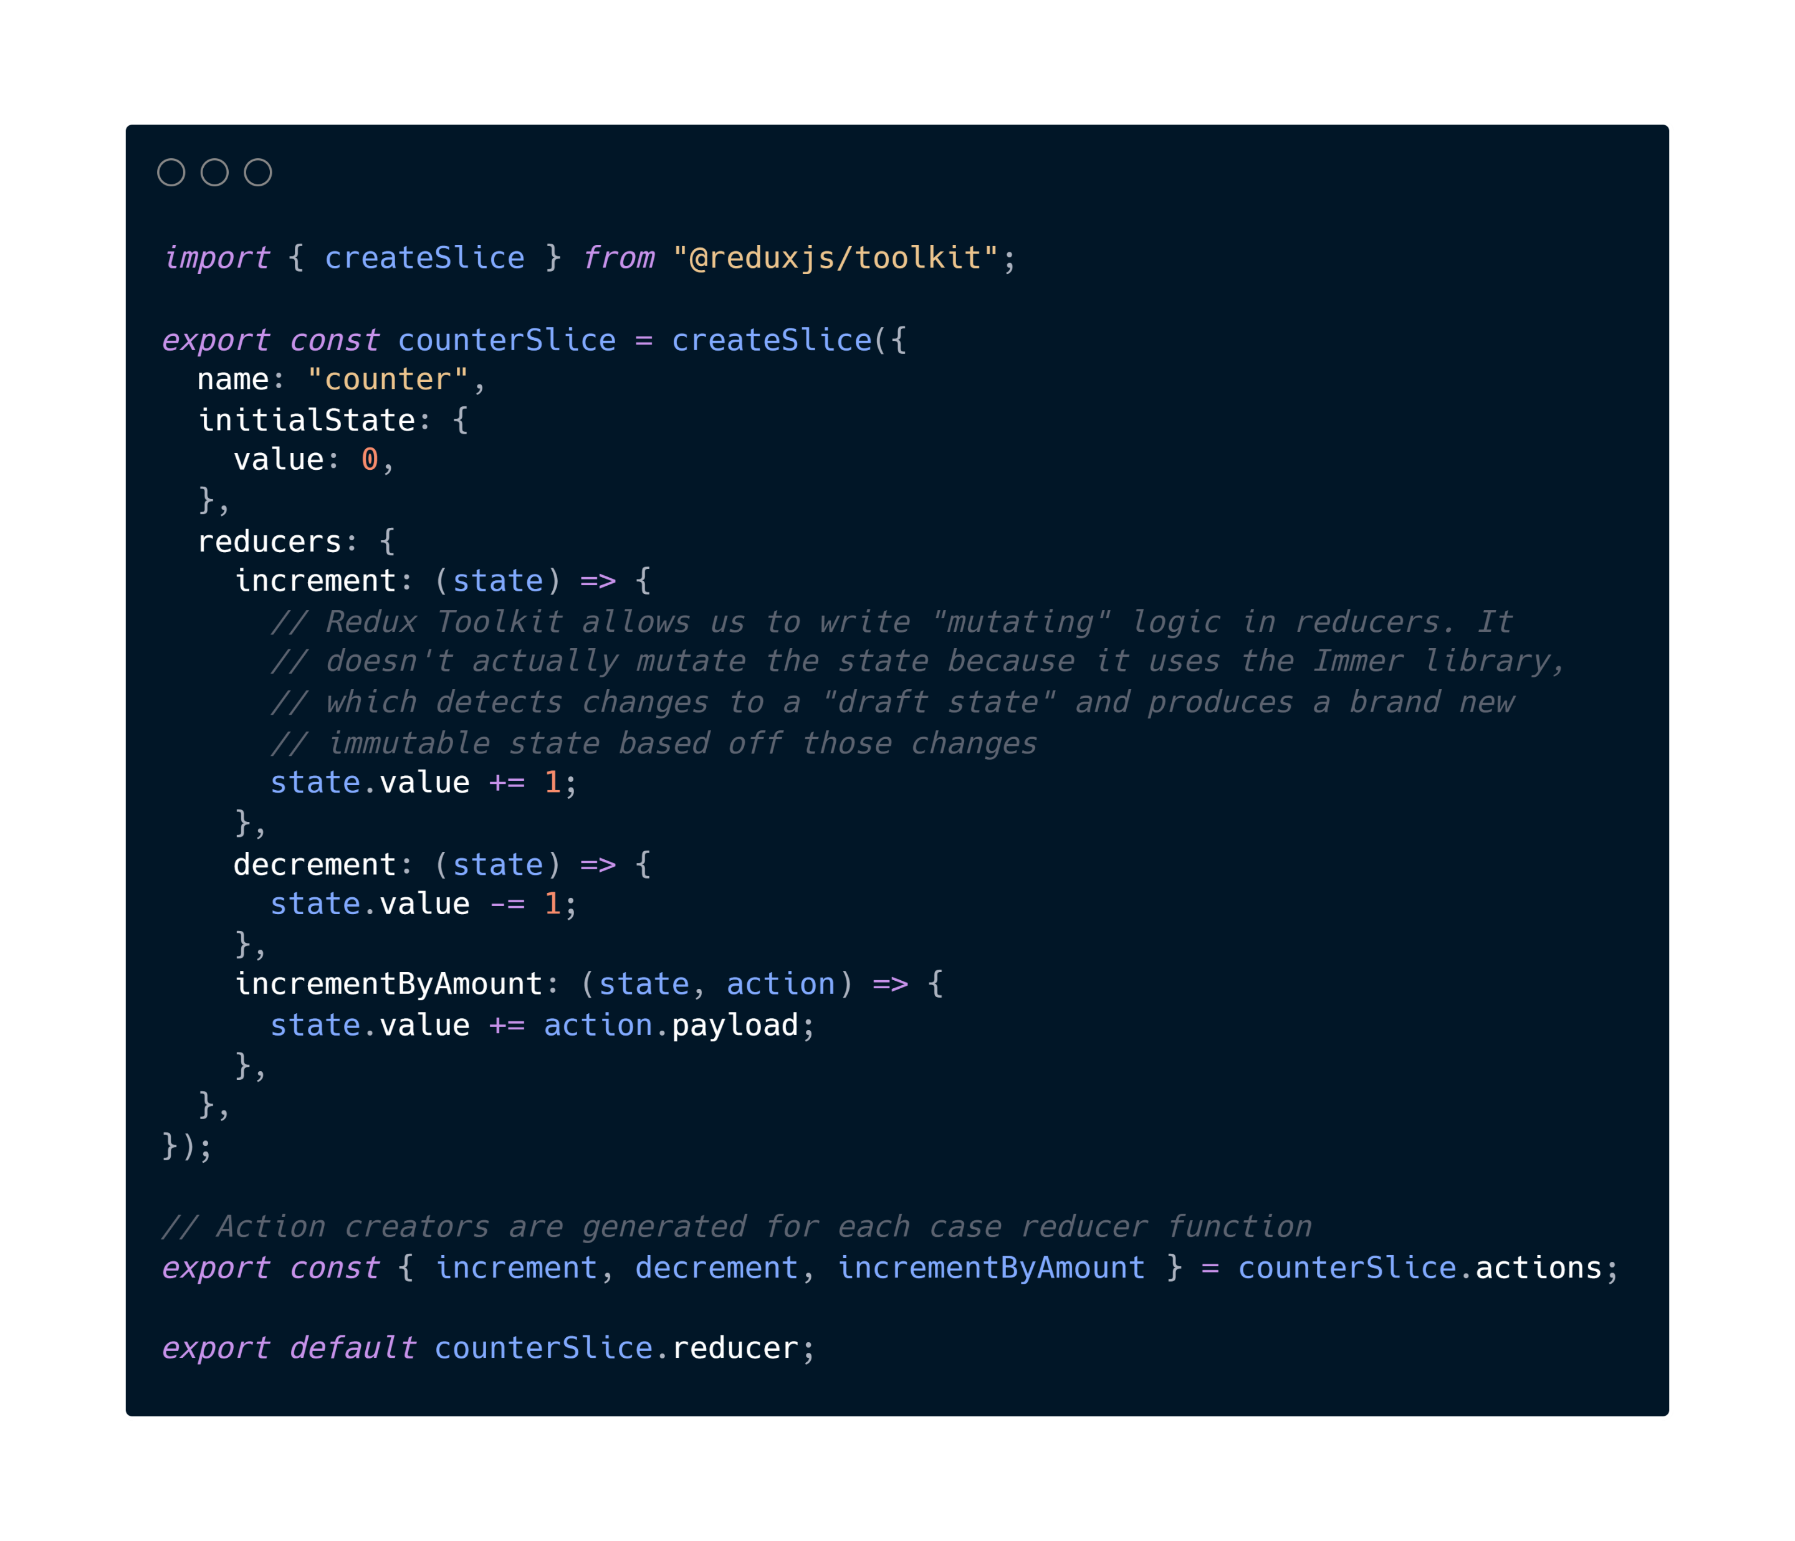
🍕 Redux State Slice
Notes:
First up, we have what is called a redux slice.
The main idea is that for each 🍕 slice of state, we want, we can call the “createSlice” function from the Redux Toolkit package.
We provide it with some parameters,
A string name to identify the slice. In this case, we have “counter” as the name
An initialState value. As we can see here, we have an initialState object with a value of 0.
Last but not least, we supply one or more reducers to define how the state can be updated. For this counter, we have an increment reducer, a decrement reducer, and an incrementByAmount reducer.
At the bottom of the file, we can then export the generated Redux action creators and the reducer function for the whole slice!

Slide 13
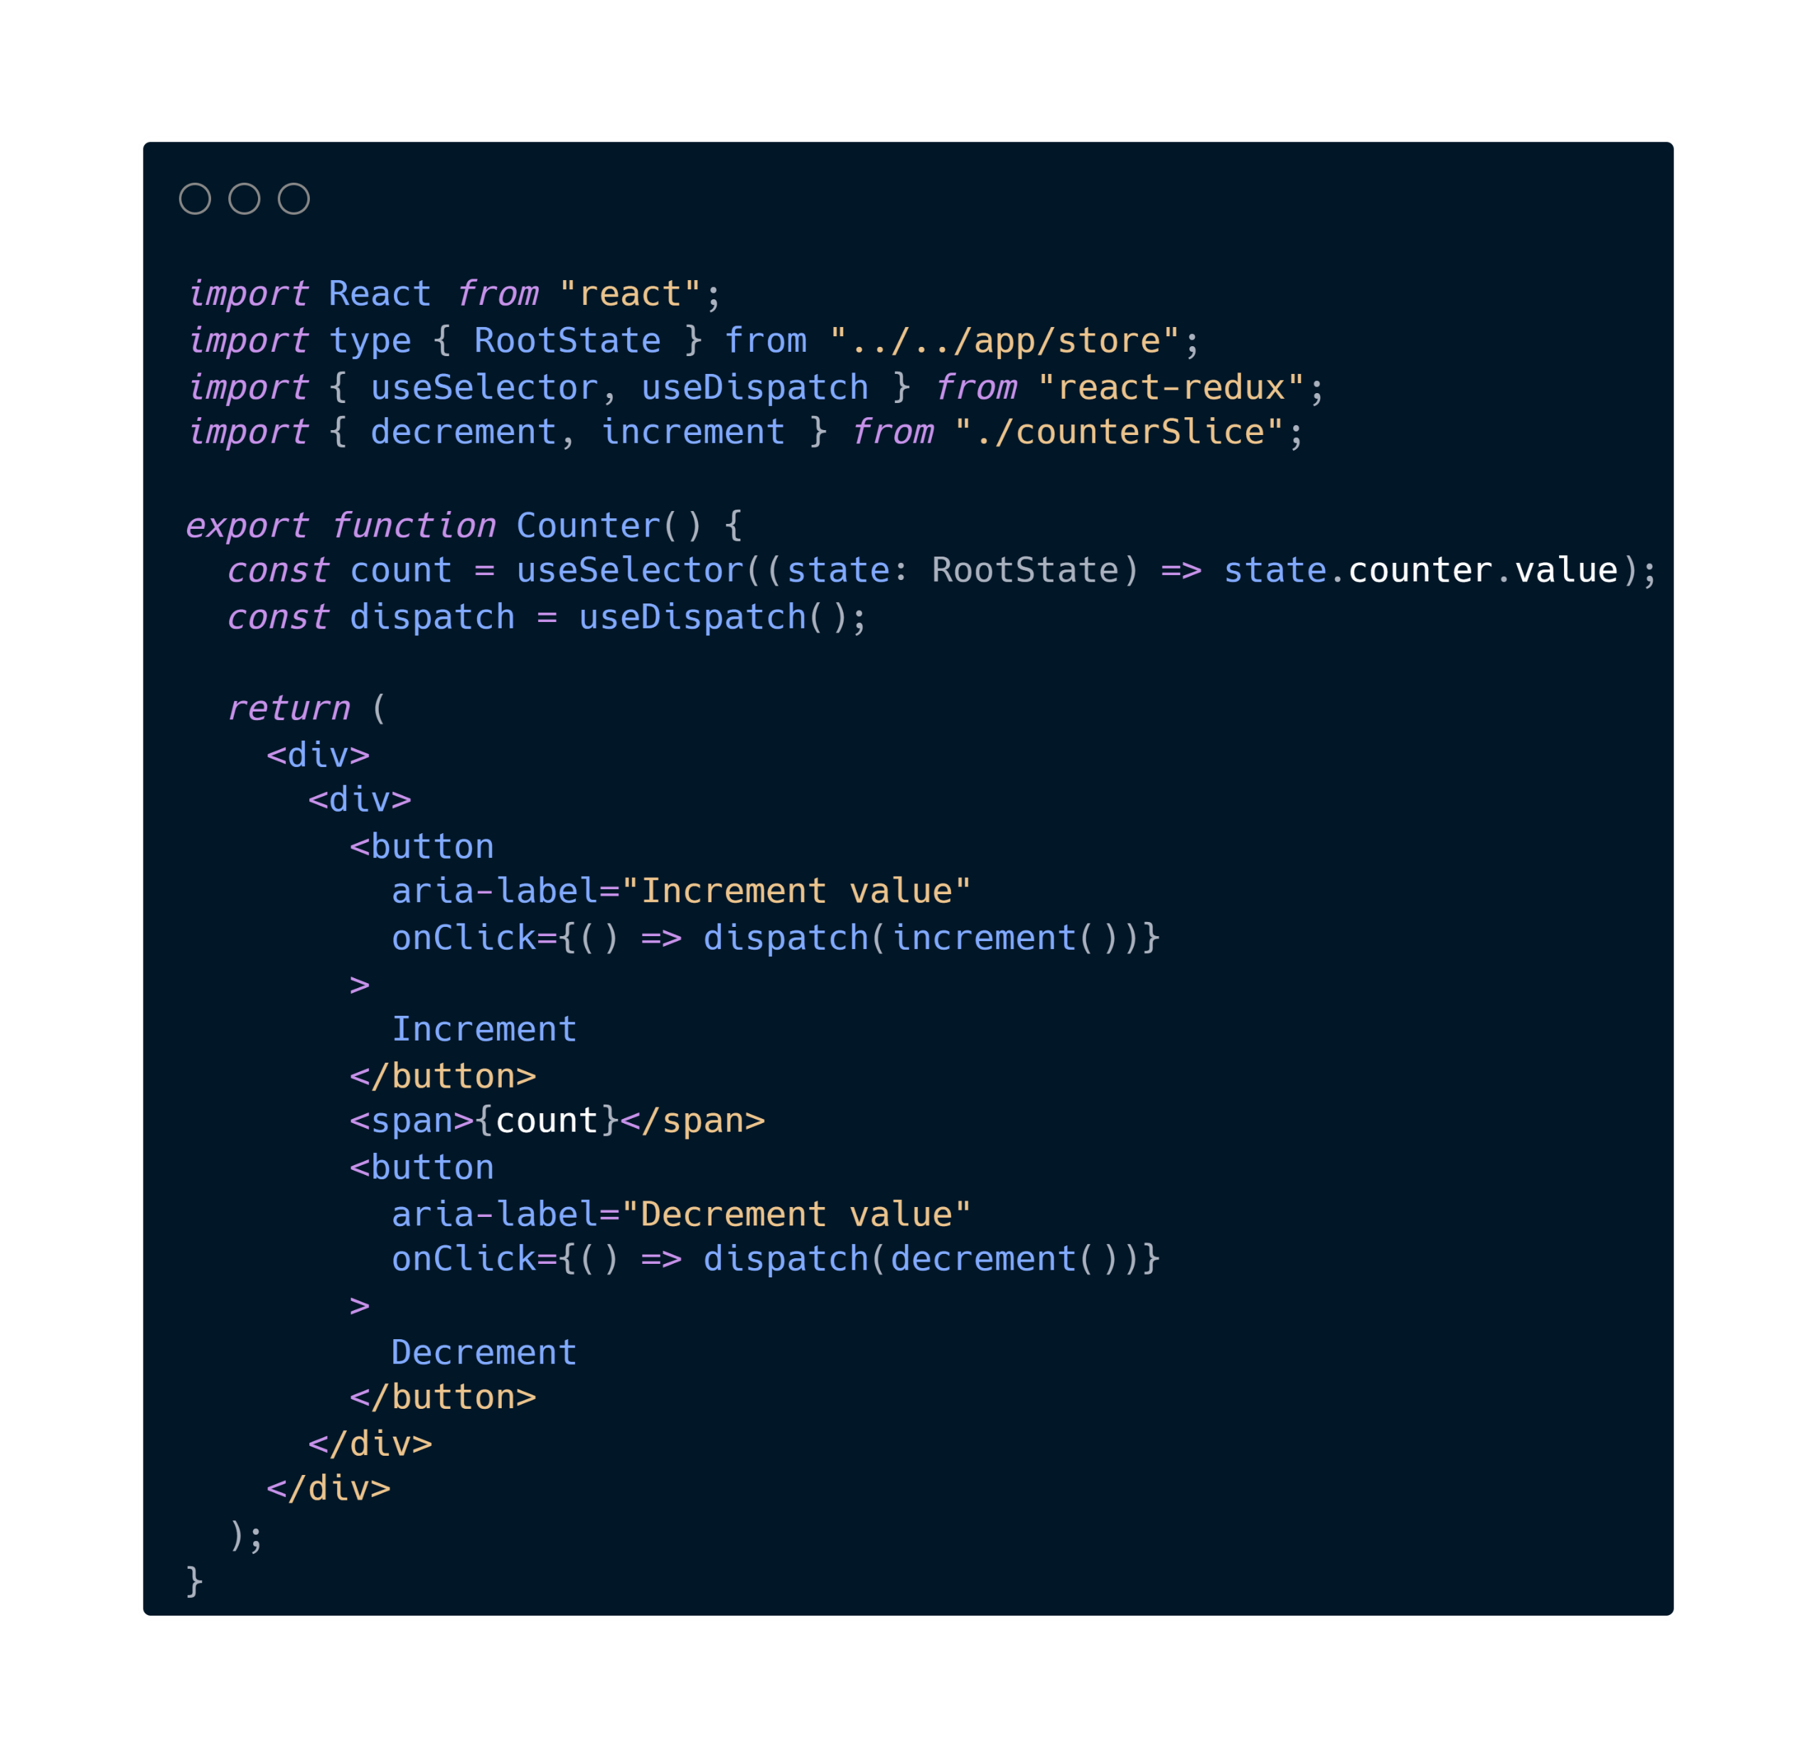
⚛️ Redux State in Components
Read data from the store with useSelector()
Dispatch actions with useDispatch()
Notes:
In React components, there’s two important hooks we can use to interact with the store.
First, we have the useSelector hook to read data from the store.
This hook subscribes to the Redux store, and forces the component to re-render when the selector that we pass in changes. So, in this case, whenever the counter value changes, the component will re-render.
Next, we have the useDispatch hook. You can use it to dispatch actions as needed.

Slide 14

Redux Saga
Overview
Notes:
Finally, let’s talk about Redux Saga.

Slide 15
🤔 What is Redux Saga?
Redux Saga is a Redux Middleware.
💡 In essence, it is a tool to help us manage asynchronous tasks, such as data fetching!

Slide 16
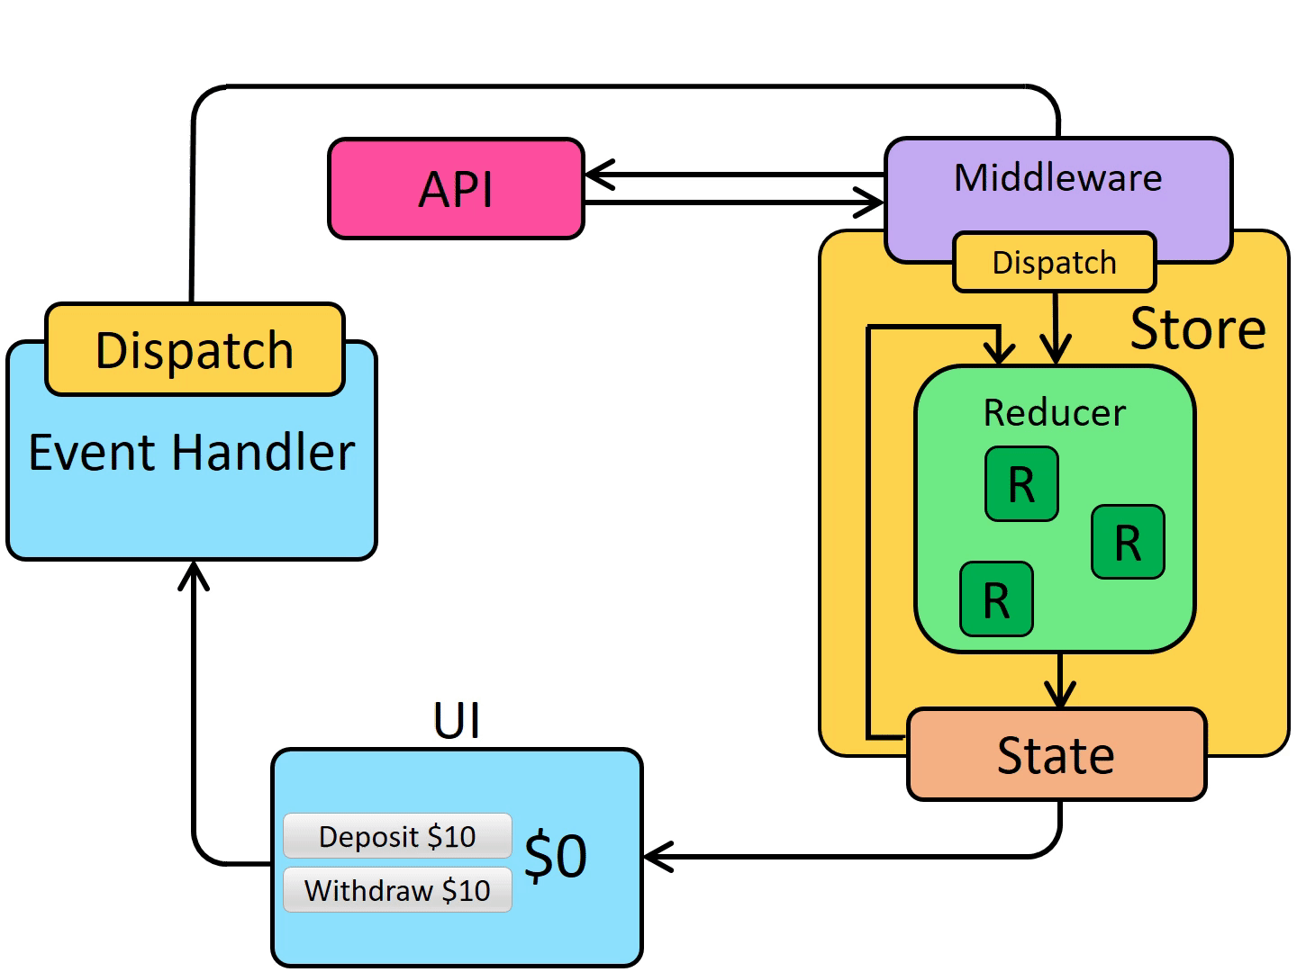
🧠 Redux Data Flow
(with middleware)
Notes:
So how do middleware and async logic affect the overall data flow of a Redux app?
It’s actually very similar to what we saw before, with additional pieces: an API and a middleware (which in this case is Redux Saga).
Just like with a normal action, we first need to handle a user event in the application, such as a click on a button.
The action is then dispatched
Then, once that dispatched action reaches a middleware, it can make an async call, and then dispatch an action when the async call completes.
💡 To summarize, when we add async logic to a Redux app, we add an extra step where middleware can run logic like data fetching requests, then dispatch actions.

Slide 17
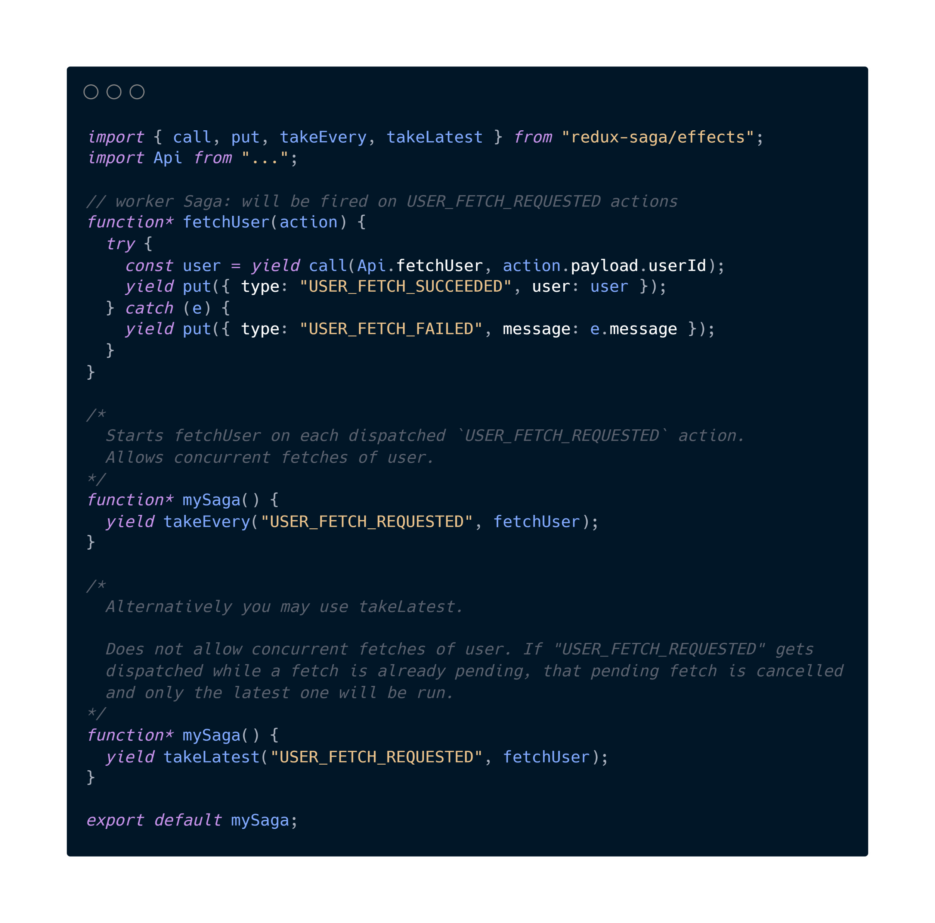
🕵️ Watchers + 👷 Workers
yield call(…)
instructs the middleware to call the function with the specified arguments
yield put(…)
instructs the middleware to schedule the dispatching of an action to the store
👷 worker
🕵️ watcher
🕵️ watcher
Notes:
Before we get into the details of this code snippet, I want to remind you that I’ll be going through a sample tutorial step by step later on, so don’t worry if you don’t understand everything at first.
Two main components of Redux Saga include the following:
Watcher Saga will watch for dispatched actions and fork a worker
Worker Saga will handle the action and terminate
The syntax of these Sagas might seem a bit different, this is because Sagas are implemented as what’s called a Generator function. We don’t need to go into too much detail, because most of it is handled implicitly by the Redux Saga middleware.
However, it’s good to know that Generators are functions that can be exited and later re-entered.
Let’s take a look at this specific example.
The watcher sagas will look out for the “USER_FETCH_REQUESTED” action. When it picks one up, it will fire the “fetchUser” worker saga.
The worker saga is what actually does the “work”. Typically, this will involve making a REST API call, and then updating the state with the response.
In a worker saga, we’ll often see yield call(…) and yield put(…)
yield call(…)
instructs the middleware to call the function with the specified arguments
yield put(…)
instructs the middleware to schedule the dispatching of an action to the store
Again, if we take a look at the fetchUser worker, the first line is const user = yield call(Api.fetchUser,… with the userId from the action payload)
Then, in the next line, after the fetch has been made, we perform a yield put of “USER_FETCH_SUCCEEDED” or “USER_FETCH_FAILED” in order to update the Redux store based on the response we got from the API.

Slide 18

😔 Redux Saga Drawbacks
Redux Saga might seem like “overkill” for a simple CRUD application
Alternatives?
React Query
...

Slide 19
Let’s Practice!
By Building a “To Do” App
Notes:
Now that we went through a whole bunch of theory, let’s get our hands dirty by actually building an application that uses Redux, Redux Toolkit, and Redux Saga!
If that interests you, stay tuned for the next video!

